Slide 1

Hybrid AI:
Fluency + Grounding
Two Kinds of Failure
Expert systems: brittle
LLMs: ungrounded
Discussion Prompt:
“What real world tasks needs both reliability and language fluency?”
Notes:
Frame the need for hybrid solutions.
Reframe the problem space:
You’ve now shown two ends of the AI spectrum:
Expert systems that are precise but narrow,
LLMs that are broad but shallow.
Define “failure modes” as structural, not accidental:
Expert systems fail when they encounter conditions outside their rule sets because they have no fallback.
LLMs fail when plausibility is mistaken for truth, because they lack grounding.
Explicit: “If one fails by constraint and the other by over-flexibility, perhaps the sweet spot is interaction, not isolation.”

Slide 2
Hybrid AI:
Fluency + Grounding
Complementary Strengths
LLM: interface
Expert system: constraints
Human: oversight
Discussion Prompt:
“How might each agent check the others?”
Notes:
Position hybrid as ecosystem, not hierarchy:
Each component does what it’s best at:
LLMs translate between human language and structured queries: they’re unparalleled interpreters,
Expert systems enforce hard constraints: they’re consistent within known boundaries,
Humans bring judgment: they know when rules don’t apply and when language is misleading.
Highlight checks and balances:
LLM spots ambiguous user intent → human clarifies,
Expert system rejects impossible combinations → LLM explains in human terms,
Human sees systematic bias → rules or data are updated.
Connect to Sessions 2 & 3 explicitly.
Review why each system had distinct failure modes; now we’re bridging.

Slide 3

Notes:
LLM recap

Slide 4
Hybrid AI:
Fluency + Grounding
LLM as Translator
Turn rules into plain language
Turn queries into structured inputs
Discussion Prompt:
“What would it look like if the LLM asked questions back instead of answering immediately?”
Notes:
Push students to think interactionally.
Frame translation as two-way:
Human → LLM → expert system input,
Expert system output → LLM → human language.
Highlight the question loop concept:
If the LLM were allowed to ask clarifying questions, it would reduce ambiguity and boost reliability, just like a good teacher.
Give a concrete mini-demo in words:
“User: ‘Is this medication okay?’
LLM: ‘Do you have these symptoms?’,
User clarifies…
Expert system checks rules…
LLM explains results.”
Multi phase: Diagnostic expert
Tie this to risk reduction:
Clarifying questions slow the process slightly but reduce hallucination and misinterpretation.

Slide 5
Hybrid AI:
Fluency + Grounding
Theoretical Example
Symptoms → LLM parse
Rule engine check
LLM explain results
Discussion Prompt:
“Where could this hybrid fail?”
Notes:
Keep focus on verification loops.
Tell the story:
Build a quick classroom script around an everyday example (medical symptoms, tax filing, scheduling).
Example:
User describes symptoms in everyday terms.
LLM parses this into structured data (e.g., list of symptoms + durations).
Expert system processes structured data against clinical rules.
LLM translates the result back into explainable language.
Highlight possible failure paths:
Misparse at the LLM stage → Rule engine gets garbage → garbage output explained convincingly.
Rules that are too narrow → correct parse but no useful result.
Human misunderstanding of the explanation → misapplied advice.
Lead students toward a verification loop:
“When do we pull back to the original user description and re-ask?”

Slide 6
Hybrid AI:
Fluency + Grounding
Concrete Examples
ChatGPT + calculator tools
ChatGPT + search / retrieval
Mezzi (AI + financial rules)
Discussion Prompt:
“Which part of each system do you trust more. Why?”
Notes:
Emphasize the meta-lesson:
This slide is where abstraction becomes real.
Example 1: ChatGPT + Calculator (or Wolfram-style tools)
What users notice: “The AI suddenly gets math right.”
What’s actually happening:
LLM does not compute reliably,
It recognizes that a computation is needed,
It delegates to a deterministic system,
Then explains the result fluently.
Why this matters pedagogically:
This is exactly your course thesis:
LLM = interface + explanation,
Tool = grounding + correctness,
Human = decides whether the result makes sense.
Tie back to:
Session 3: Fluency without understanding
Session 5: LLMs as multipliers
Example 2: ChatGPT + Search / Retrieval (RAG)
Key hybrid idea:
The LLM is no longer inventing answers from memory — it is anchored to external sources.
Failure mode reduction:
Less hallucination,
More traceability,
Still not perfect (sources can be wrong).
Important nuance for students:
This feels like intelligence, but it’s actually good orchestration.
You can ask:
“Is this smarter — or just better designed?”
Example 3: Mezzi (Financial AI + Rule Systems)
Why this is a great teaching example:
Finance is high-stakes,
Rules matter (tax law, budgeting constraints),
Language matters (user explanations, goals).
Hybrid structure (simplified):
LLM gathers goals in conversational form,
Financial rules enforce constraints,
LLM explains tradeoffs in human language.
Crucial point:
Mezzi doesn’t remove responsibility — it shapes decisions, which means:
Over-trust is still dangerous,
Human judgment remains essential.
These systems didn’t become safer because the LLM “got smarter.”
They became safer because:
The LLM was put in the right role,
Constraints were explicit,
Humans stayed involved.
Reinforce the continuum framing:
“This isn’t AI vs non-AI. It’s where you place flexibility and where you enforce rigidity.”

Slide 7
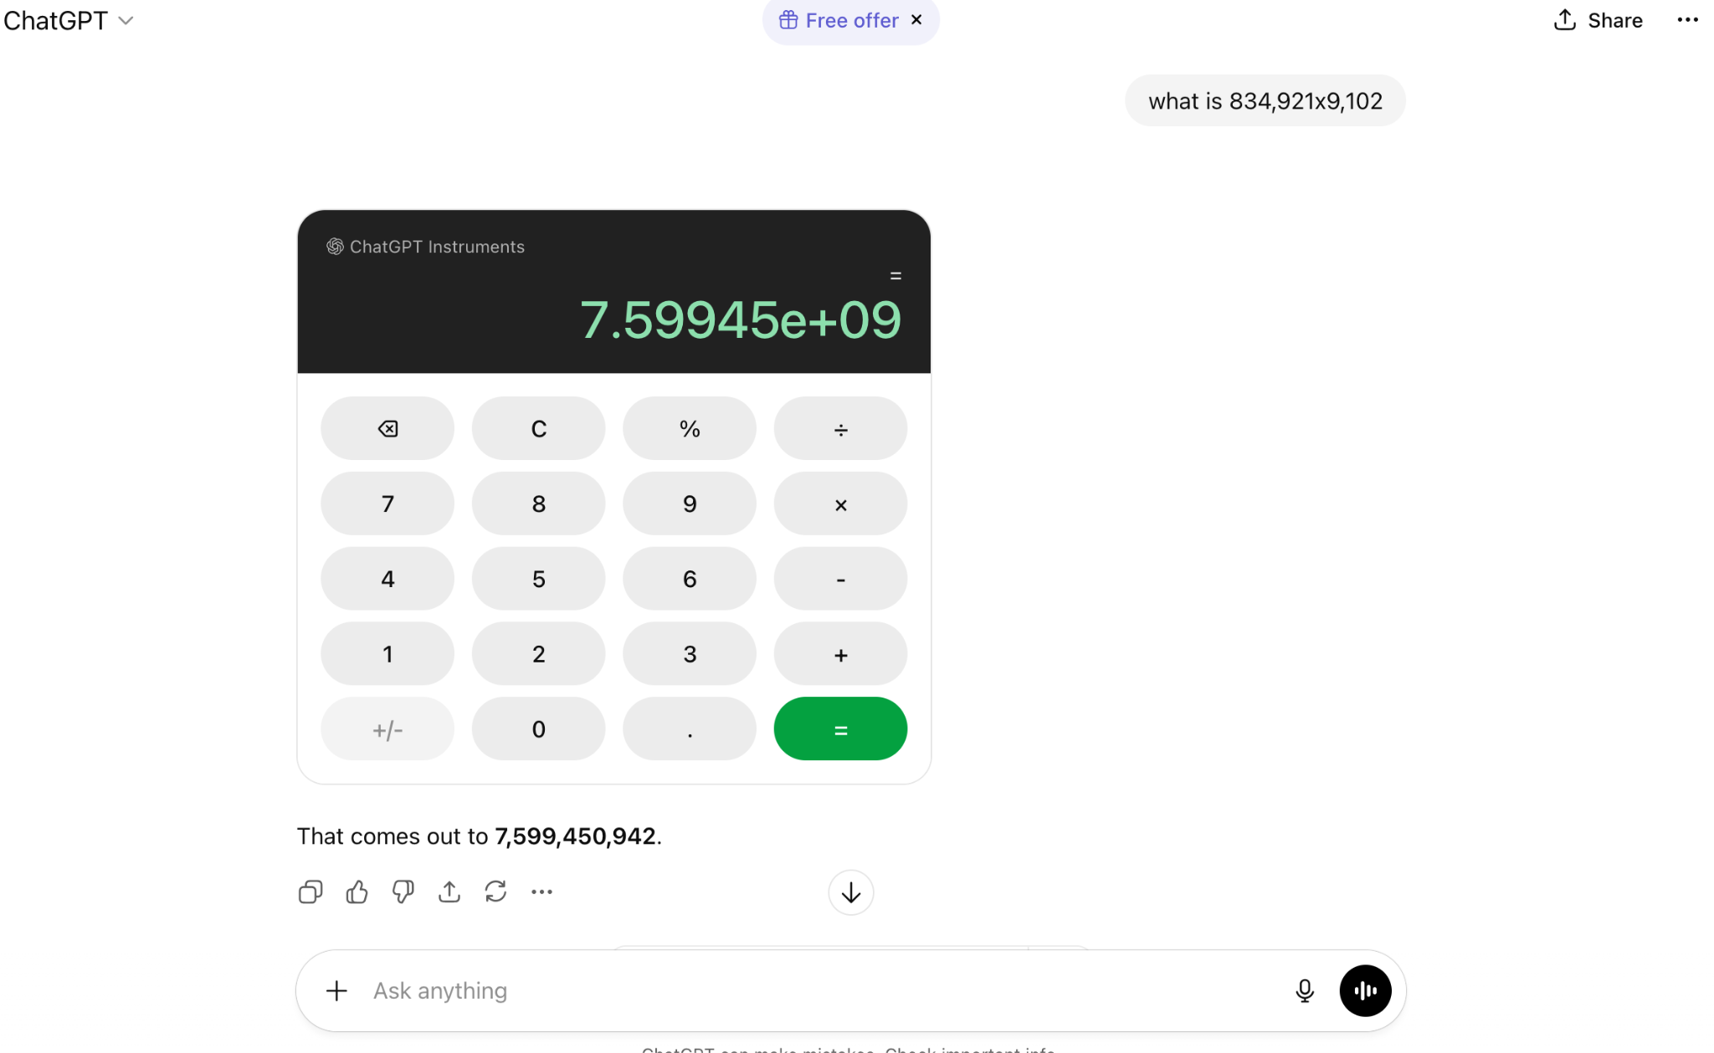
Notes:
Note that the ChatGPT Instruments is invoked.

Slide 8
Hybrid AI:
Fluency + Grounding
What this Fixes
Reduces hallucination (but not eliminate!)
Preserves explainability (to a large extent)
Human in the loop
Discussion Prompt:
“What trade-offs remain?”
Notes:
Be realistic: hybrids are not panaceas, they are a step in the iterative process of development.
Define what gets better vs what still needs scrutiny:
Reduces hallucination: grounded checks prevent fluent nonsense from being used uncritically.
Preserves explainability: expert systems are traceable; LLMs translate without obfuscating logic.
Human in the loop: ensures accountability and context-sensitive judgment.
But push them to think about what isn’t fixed:
Errors in the rules
Bias in training data
Misaligned incentives (e.g., speed over safety)
Use examples:
An answer that checks out logically but doesn’t fit human intent, students should catch that.

Slide 9
Hybrid AI:
Fluency + Grounding
What it Doesn’t Fix
Bad rules
Biased data
Human over-trust
Discussion Prompt:
“What’s the biggest unresolved challenge?”
Notes:
Open future thinking.
Re-center responsibility on humans and data:
Bad rules still yield bad conclusions regardless of interface.
Biased data will skew interpretation if not audited.
Human over-trust can turn a hybrid system into a crutch just as easily.
Ask students to name scenarios where each bullet manifests.
Example: Medical rules biased toward one population → poor outcomes even with hybrid systems.
Wrap toward future thinking:
“If we cannot fix all of this now, what practices should we adopt to manage risk?”

